Slide 1
Network Intrusion Detection using Machine Learning
Gotam Sai Varshith - 22BCE1605
PAVAN KRISHNA R - 24BCE5294
MRINAL SWAIN - 24BCE5357

Slide 2
Presentation Agenda
1. Introduction: The Problem and Our Motivation
2. Background: What is a Network Intrusion Detection System (NIDS)?
3. The Challenge: Why Use Machine Learning?
4. Methodology: Our End-to-End Project Workflow
5. The Dataset: A Look at NSL-KDD
6. The Models: KNN, LDA, and SVM
7. Implementation: The Training Pipeline and Streamlit App
8. Live Demonstration: A Walkthrough of the Dashboard
9. Results: Comparative Analysis of Model Performance
10. Conclusion & Future Work

Slide 3
The Modern Cybersecurity Challenge
Hyper-Connected World: Our modern infrastructure (finance, healthcare, energy) is built on complex, interconnected networks.
Evolving Threat Landscape: Cyber threats are no longer static. We face sophisticated, automated, and "zero-day" attacks that have never been seen before.
The Need for Intelligent Defense: We need security systems that are not just reactive, but proactive, adaptive, and intelligent.
Project Goal: To build and evaluate an intelligent, anomaly-based Network Intrusion Detection System (NIDS) using classical machine learning algorithms.

Slide 4
The Digital Security Guard
Core Function: A NIDS is a system that continuously monitors network traffic for suspicious activity, policy violations, or outright malicious threats.
Analogy:
A Firewall is like a locked door. It blocks known bad traffic.
A NIDS is like a security guard who watches for suspicious behavior—someone picking the lock, looking in windows, or acting abnormally.
It acts as a critical second line of defense, catching threats that may have bypassed the firewall.

Slide 5
Two Main Approaches to Detection
Signature-Based Detection:
How it Works: Matches network traffic against a database of known attack patterns (signatures).
Pros: Very fast and accurate for known threats. Low false positive rate.
Cons: Completely blind to new, "zero-day" attacks. Requires constant updates to its signature database.
Anomaly-Based Detection:
How it Works: First, it learns a baseline of what "normal" network behavior looks like. Then, it flags any significant deviation from that baseline as a potential attack.
Pros: Can detect novel and zero-day attacks. More adaptive to new threats.
Cons: Can have a higher false positive rate if the "normal" model isn't perfect.
Our Focus: This project focuses on building a powerful Anomaly-Based NIDS using Machine Learning.

Slide 6
The Power of Data-Driven Security
The Problem with Manual Systems:
Modern networks are massive and generate terabytes of data. Manual analysis is impossible.
Traditional, rule-based systems can't keep up with the speed and creativity of new attacks.
How Machine Learning Helps:
Scalability: ML algorithms can analyze massive volumes of network data efficiently.
Pattern Recognition: They can autonomously learn the complex patterns of both normal and malicious behavior without being explicitly programmed.
Adaptability: ML models can identify new and evolving threats, making them ideal for anomaly detection.
Reduced Manual Effort: Reduces the need for security experts to constantly write and update thousands of detection rules.

Slide 7
A Structured, End-to-End Approach
Phase 1: Data Acquisition & Preprocessing
Procured the benchmark NSL-KDD dataset.
Performed rigorous data cleaning, encoding of categorical features, and normalization of numerical features.
Phase 2: Model Training & Evaluation
Trained three different ML models: KNN, LDA, and SVM.
Evaluated each model on an unseen test set using standard metrics (Accuracy, Precision, etc.).
Phase 3: Asset Serialization
Identified the best-performing model based on evaluation results.
Saved the trained model, data scaler, and feature list as .pkl files.
Phase 4: Application Development
Built an interactive web dashboard using Streamlit.
Integrated the saved ML assets into the app for real-time predictions.

Slide 8
The Benchmark for NIDS Research
Source: An improved and refined version of the classic KDD Cup 1999 dataset.
Key Improvement: Removes redundant records, providing a more realistic and unbiased environment for model evaluation.
Structure:
Each record represents a network connection.
Each connection is described by 41 features (e.g., duration, protocol_type, src_bytes).
Classes: Labeled as either 'Normal' or one of four main attack categories:
DoS (Denial of Service)
Probe (Probing)
R2L (Remote to Local)
U2R (User to Root)
For our project, we simplified this to a binary classification problem: 'Normal' vs. 'Attack'.

Slide 9
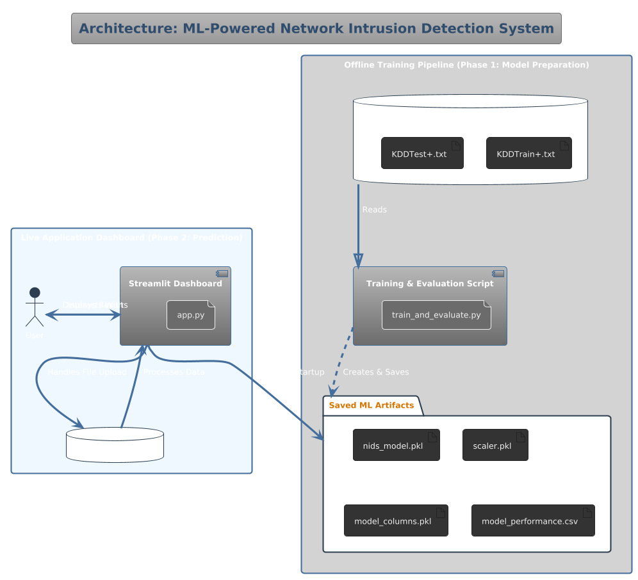
System Architecture

Slide 10
Our Chosen Algorithms
K-Nearest Neighbors (KNN):
An instance-based “lazy learner.“
Classifies a connection based on the majority class of its 'k' closest neighbors in the feature space.
Simple, yet surprisingly effective for pattern recognition.
Linear Discriminant Analysis (LDA):
A statistical method that finds a linear combination of features to best separate the classes.
Computationally fast and efficient, but assumes a linear relationship in the data.
Support Vector Machine (SVM):
A powerful classifier that finds the optimal "hyperplane" or decision boundary that best separates normal and attack data points.
Known for its robustness in high-dimensional spaces. We used a linear kernel for efficiency.

Slide 11
Bringing the Model to Life
Technology: We used Streamlit, a Python framework for building beautiful, interactive web apps for machine learning and data science.
Key Features of Our Dashboard:
File Uploader: Allows users to upload one or more CSV files for analysis.
Dynamic UI: The analysis results only appear after a file is uploaded, keeping the interface clean.
Real-Time Prediction: The app preprocesses the uploaded data and uses the saved best model to make predictions instantly.
Tabbed Results: The output is neatly organized into tabs:
Prediction Summary: High-level metrics and an "Attack Detected!" warning.
Detailed Results: A row-by-row table with predictions, with attacks highlighted.
Input Data: A preview of the user's original data.

Slide 12
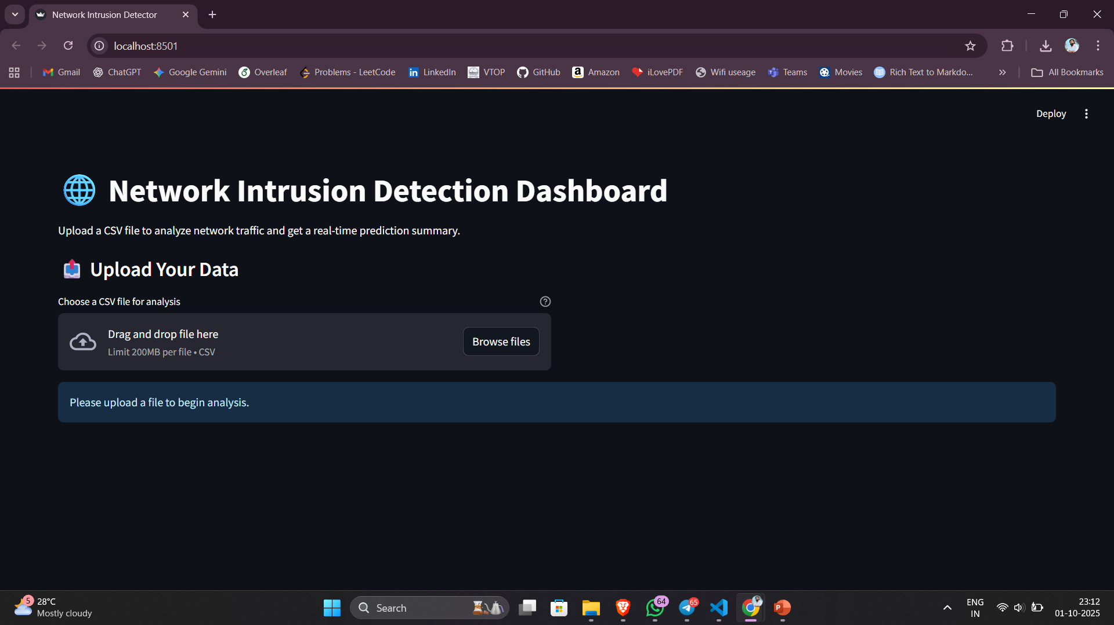
Bringing the Model to Life

Slide 13
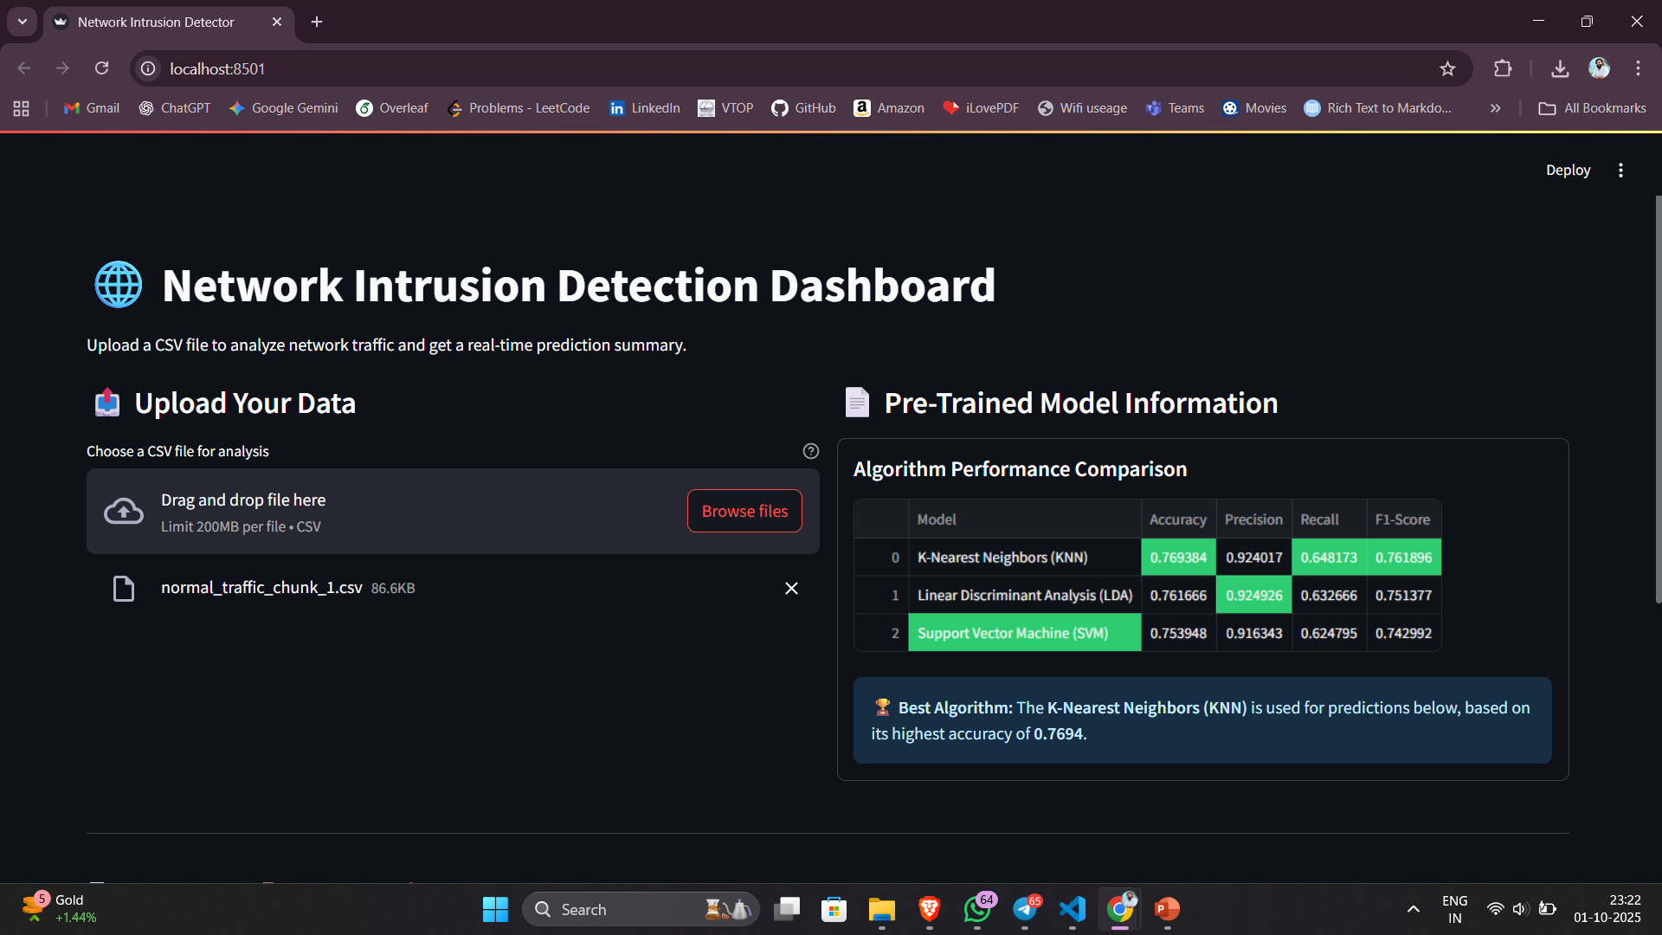
Sample Outputs

Slide 14
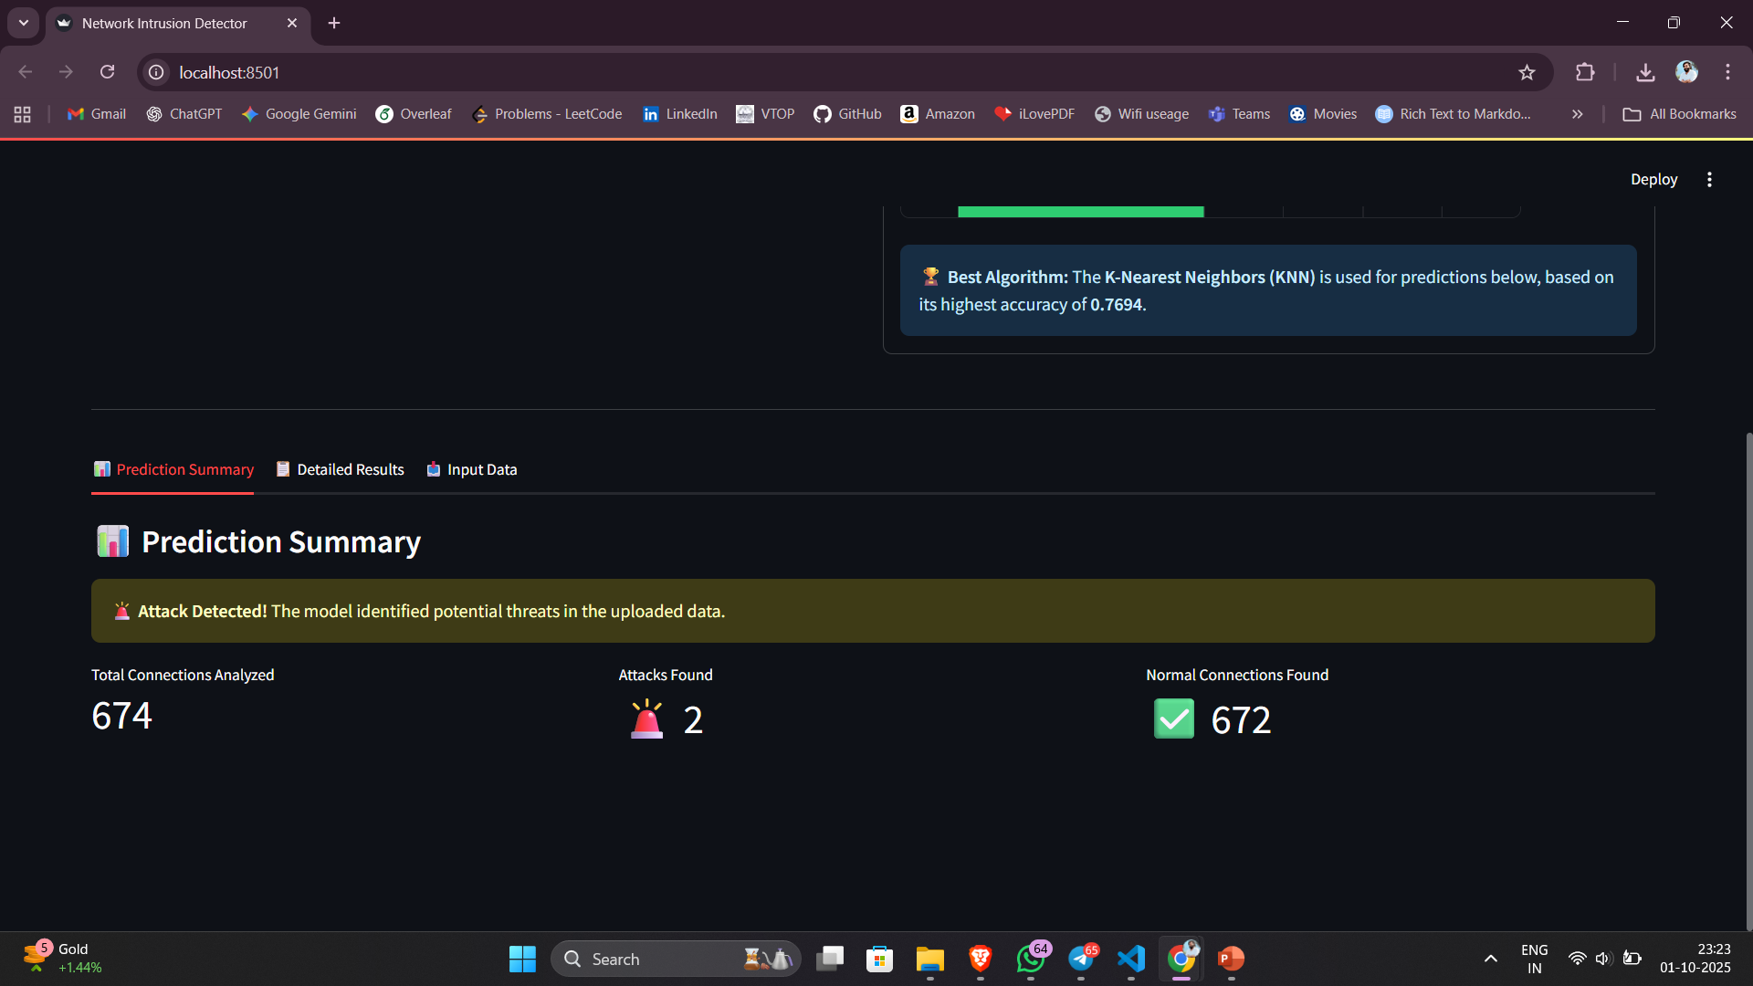
Sample Outputs

Slide 15
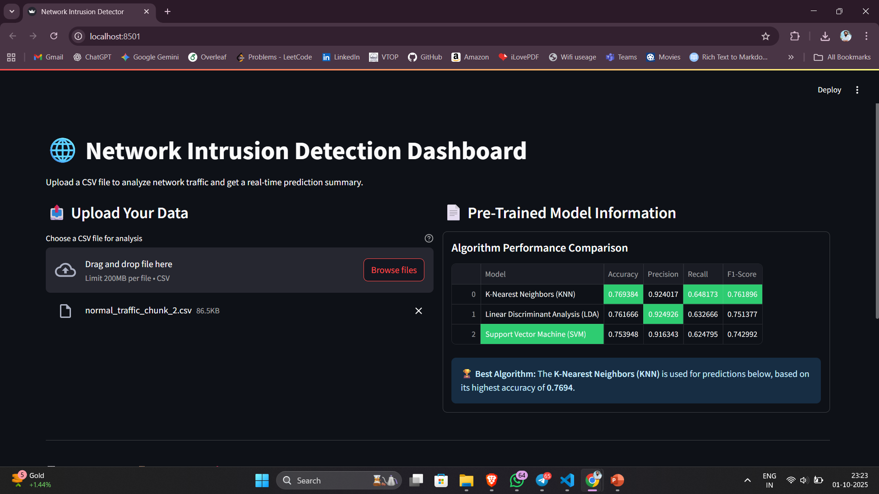
Sample Outputs

Slide 16
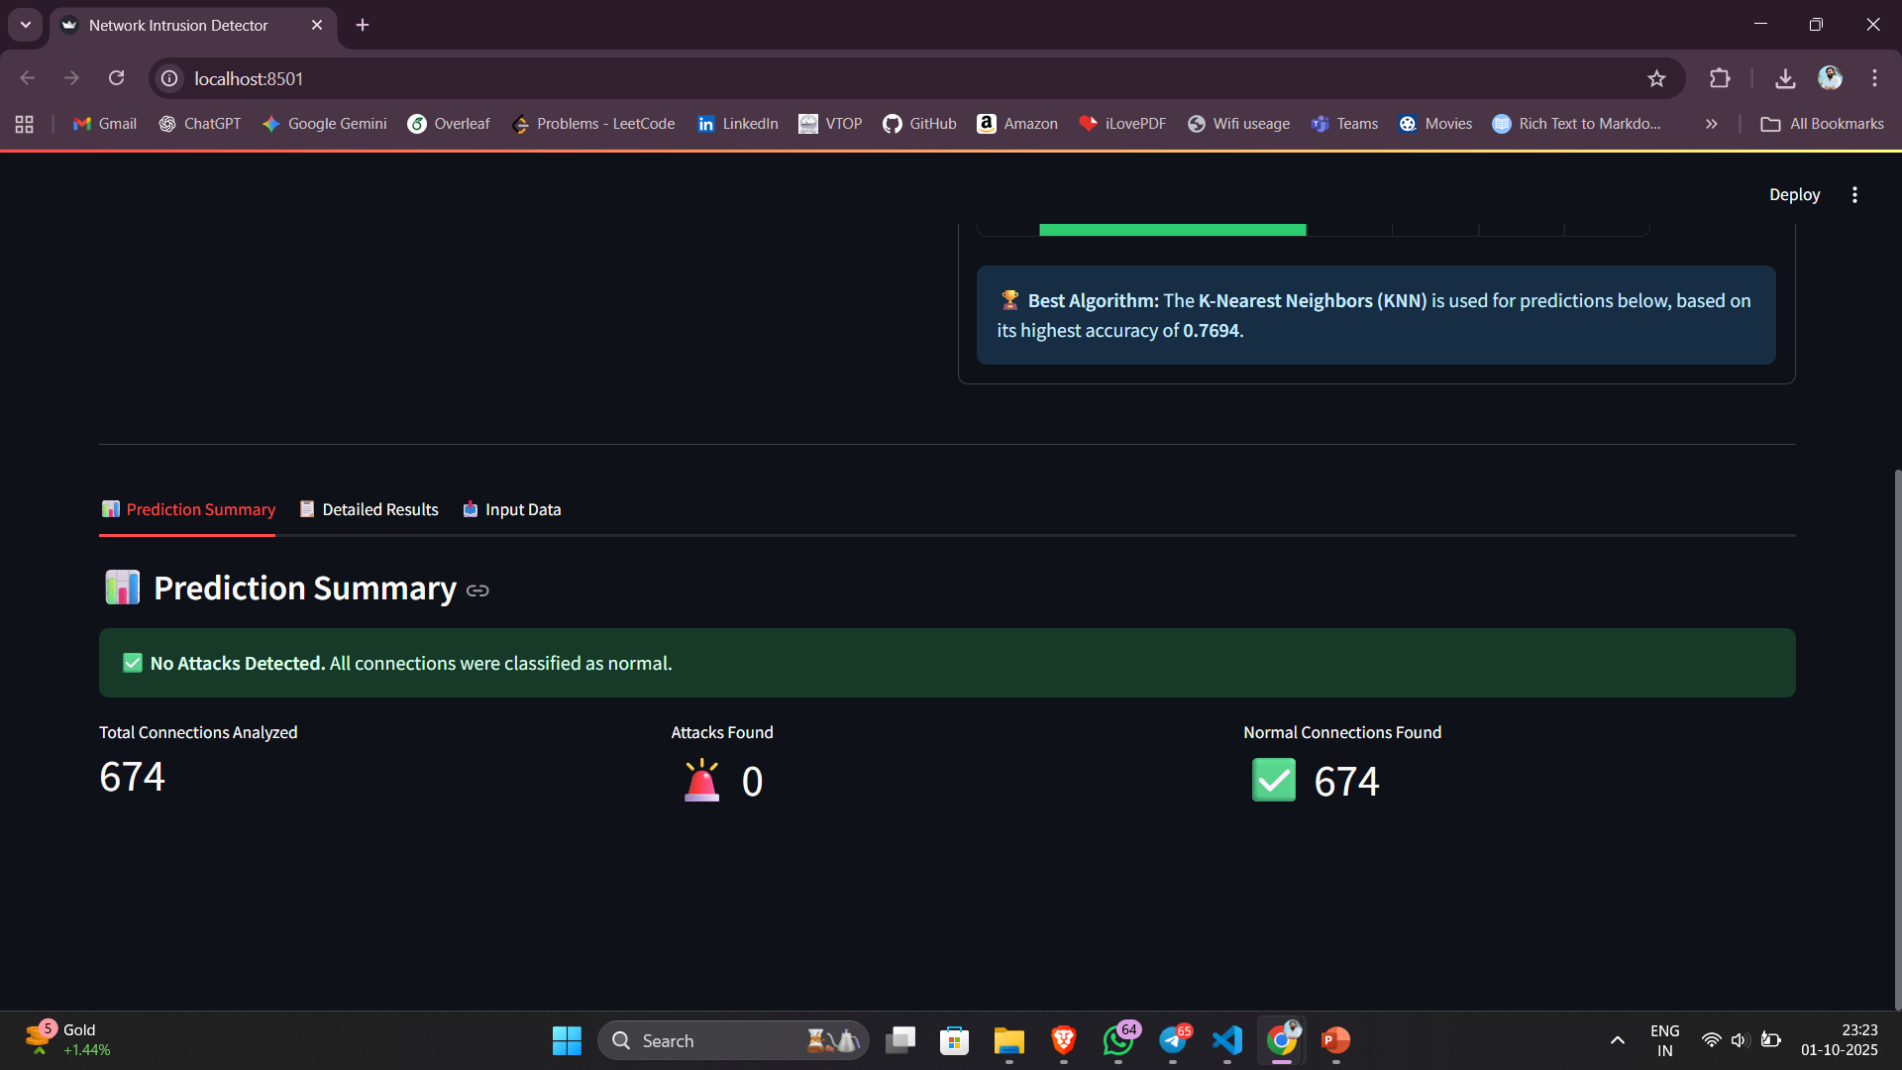
Sample Outputs

Slide 17
Which Model Performed the Best?
We evaluated all three models on the unseen NSL-KDD test set. The results are as follows:
Model | Accuracy | Precision | Recall | F1-Score
KNN | 0.7694 | 0.9240 | 0.6482 | 0.7619
LDA | 0.7617 | 0.9249 | 0.6327 | 0.7514
SVM | 0.7539 | 0.9163 | 0.6248 | 0.7430

Slide 18
Summary of Achievements and Next Steps
Conclusion:
Successfully demonstrated that classical machine learning provides a powerful and effective foundation for building anomaly-based NIDS.
Developed a complete, end-to-end project, from data preprocessing to a fully functional and interactive web application.
Empirically proved that KNN was the most suitable model for this specific task on the NSL-KDD dataset.
Future Work:
Integrate Deep Learning Models: Explore advanced models like LSTMs or Autoencoders, which might capture more complex patterns.
Test on Modern Datasets: Evaluate the models on newer datasets like CIC-IDS2017 to ensure relevance against modern threats.
Develop a Real-Time Pipeline: Enhance the application to capture and analyze live network traffic directly, instead of relying on file uploads.
Implement Multi-Class Classification: Upgrade the model to not just detect attacks, but also classify the type of attack (e.g., DoS, Probe).

Slide 19


